Slide 1
BROADBAND PROJECT
EXECUTIVE SUMMARY
Lee County, Alabama
March 2023

Slide 2
Mission:
Determine the feasibility of and develop a plan to provide broadband internet service to as many citizens of Lee County as possible.
Notes:
This ELCO specific study tells us many things such as the unserved and underserved areas of the county.
And we now know what percentage of our overall population have no access to a Broadband signal at their home of business.
And have a better understanding of what it would cost to expand infrastructure in ELCO
We know expanding Bb infrastructure would include hanging or burring physical fiber in the most densely populated underserved or unserved areas or it could mean installing towers to deliver a wireless Bb signal and our original plans included installing Hotspots in the least populated areas of the county where there would be very little Bb infrastructure installed so at minimum a citizen could drive to a nearby location and gain access to a signal.
And then just like all of us have experienced, along comes COVID-19 and all plans were changed.
ELCO BOE Superintendent Richard Dennis called in March saying he needed help in putting together a plan on how he could remotely deliver an education to his students if schools were closed and not reopened to finish the school year and he knew students having access to a broadband signal would be crucial to his plan
Well, we were ready to help.
Our original overall Bb infrastructure expansion plans included using hotspots last, but hotspots would now be installed first because they could be deployed quickly.
We just needed to determine where the hotpots should be installed that would service the greatest number of students and citizens, now and in the future and that data was available in our Broadband Feasibility Study.

Slide 3
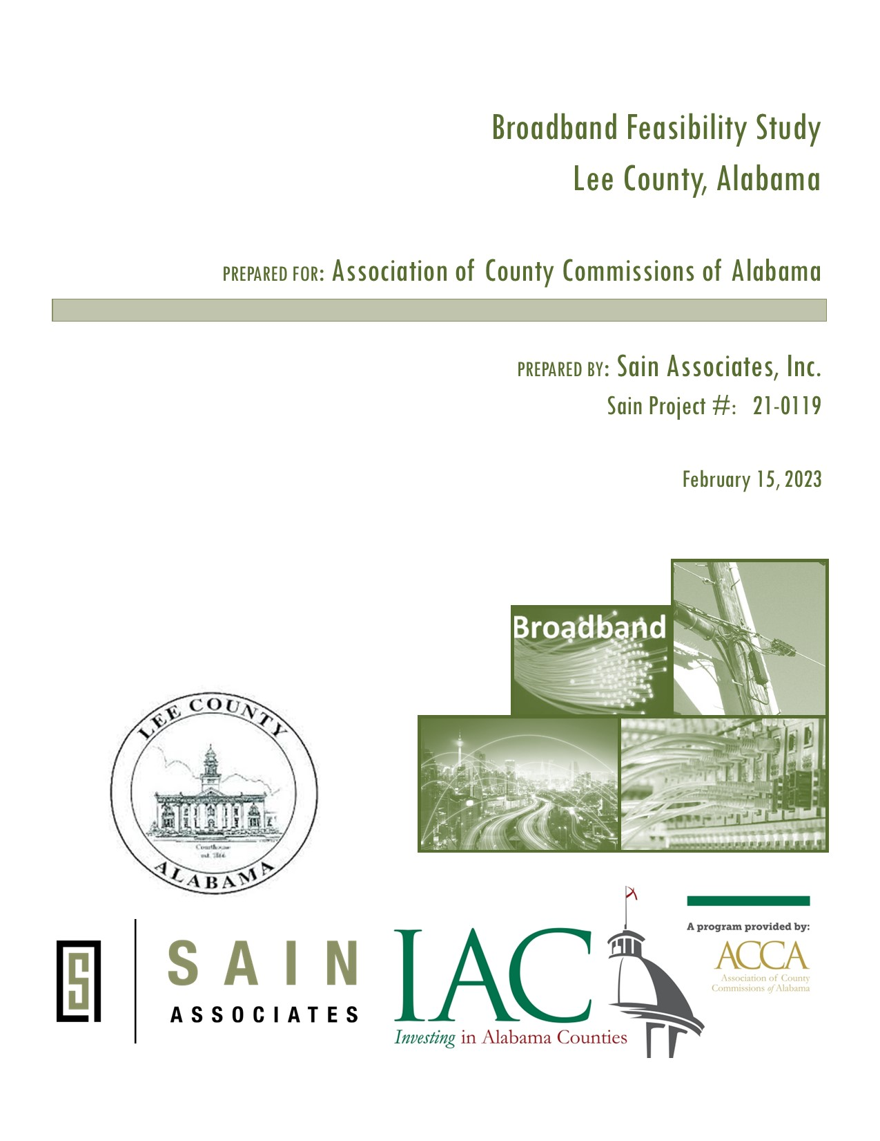
Feasibility Study – Phase 1
Broadband data was collected and developed by Sain Associates, and they created a Broadband Feasibility Study.
Objectives of the Study:
Define clear broadband coverage goals and benchmarks.
Document existing broadband infrastructure and coverage areas.
Develop a plan for addressing gaps in broadband service.
Develop short and long-term recommendations.
Compile information needed to apply for grant and/or other funding.
Notes:
This ELCO specific study tells us many things such as the unserved and underserved areas of the county.
And we now know what percentage of our overall population have no access to a Broadband signal at their home of business.
And have a better understanding of what it would cost to expand infrastructure in ELCO
We know expanding Bb infrastructure would include hanging or burring physical fiber in the most densely populated underserved or unserved areas or it could mean installing towers to deliver a wireless Bb signal and our original plans included installing Hotspots in the least populated areas of the county where there would be very little Bb infrastructure installed so at minimum a citizen could drive to a nearby location and gain access to a signal.
And then just like all of us have experienced, along comes COVID-19 and all plans were changed.
ELCO BOE Superintendent Richard Dennis called in March saying he needed help in putting together a plan on how he could remotely deliver an education to his students if schools were closed and not reopened to finish the school year and he knew students having access to a broadband signal would be crucial to his plan
Well, we were ready to help.
Our original overall Bb infrastructure expansion plans included using hotspots last, but hotspots would now be installed first because they could be deployed quickly.
We just needed to determine where the hotpots should be installed that would service the greatest number of students and citizens, now and in the future and that data was available in our Broadband Feasibility Study.

Slide 4
Broadband Goals
Evaluate and understand existing broadband infrastructure condition
Evaluate public opinion of existing broadband services and interest in expanding capabilities
Make at least one (1) broadband internet service provider available to 95% of the County
Make at least two (2) broadband internet service providers available to 85% of the County
Create competition amongst internet providers that benefit customers with better service and lower prices
Notes:
This ELCO specific study tells us many things such as the unserved and underserved areas of the county.
And we now know what percentage of our overall population have no access to a Broadband signal at their home of business.
And have a better understanding of what it would cost to expand infrastructure in ELCO
We know expanding Bb infrastructure would include hanging or burring physical fiber in the most densely populated underserved or unserved areas or it could mean installing towers to deliver a wireless Bb signal and our original plans included installing Hotspots in the least populated areas of the county where there would be very little Bb infrastructure installed so at minimum a citizen could drive to a nearby location and gain access to a signal.
And then just like all of us have experienced, along comes COVID-19 and all plans were changed.
ELCO BOE Superintendent Richard Dennis called in March saying he needed help in putting together a plan on how he could remotely deliver an education to his students if schools were closed and not reopened to finish the school year and he knew students having access to a broadband signal would be crucial to his plan
Well, we were ready to help.
Our original overall Bb infrastructure expansion plans included using hotspots last, but hotspots would now be installed first because they could be deployed quickly.
We just needed to determine where the hotpots should be installed that would service the greatest number of students and citizens, now and in the future and that data was available in our Broadband Feasibility Study.

Slide 5
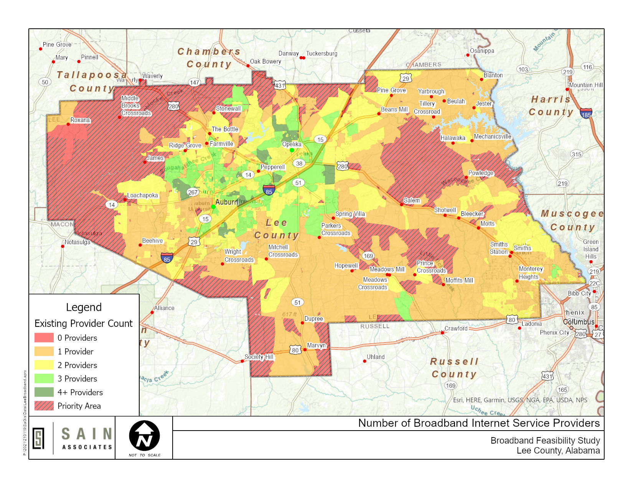
Existing Conditions
By 616 Square Miles Land Area
Condition based on FCC Area
Unserved areas (0 Broadband Providers) = 29.6%
Underserved areas (1 Broadband Provider) = 42.1%
Condition based on Parcels
Uninhabited property = 66.1%
Inhabited parcels with no providers = 12.9%
Inhabited parcels with 1 provider = 50.6%
Notes:
This ELCO specific study tells us many things such as the unserved and underserved areas of the county.
And we now know what percentage of our overall population have no access to a Broadband signal at their home of business.
And have a better understanding of what it would cost to expand infrastructure in ELCO
We know expanding Bb infrastructure would include hanging or burring physical fiber in the most densely populated underserved or unserved areas or it could mean installing towers to deliver a wireless Bb signal and our original plans included installing Hotspots in the least populated areas of the county where there would be very little Bb infrastructure installed so at minimum a citizen could drive to a nearby location and gain access to a signal.
And then just like all of us have experienced, along comes COVID-19 and all plans were changed.
ELCO BOE Superintendent Richard Dennis called in March saying he needed help in putting together a plan on how he could remotely deliver an education to his students if schools were closed and not reopened to finish the school year and he knew students having access to a broadband signal would be crucial to his plan
Well, we were ready to help.
Our original overall Bb infrastructure expansion plans included using hotspots last, but hotspots would now be installed first because they could be deployed quickly.
We just needed to determine where the hotpots should be installed that would service the greatest number of students and citizens, now and in the future and that data was available in our Broadband Feasibility Study.

Slide 6
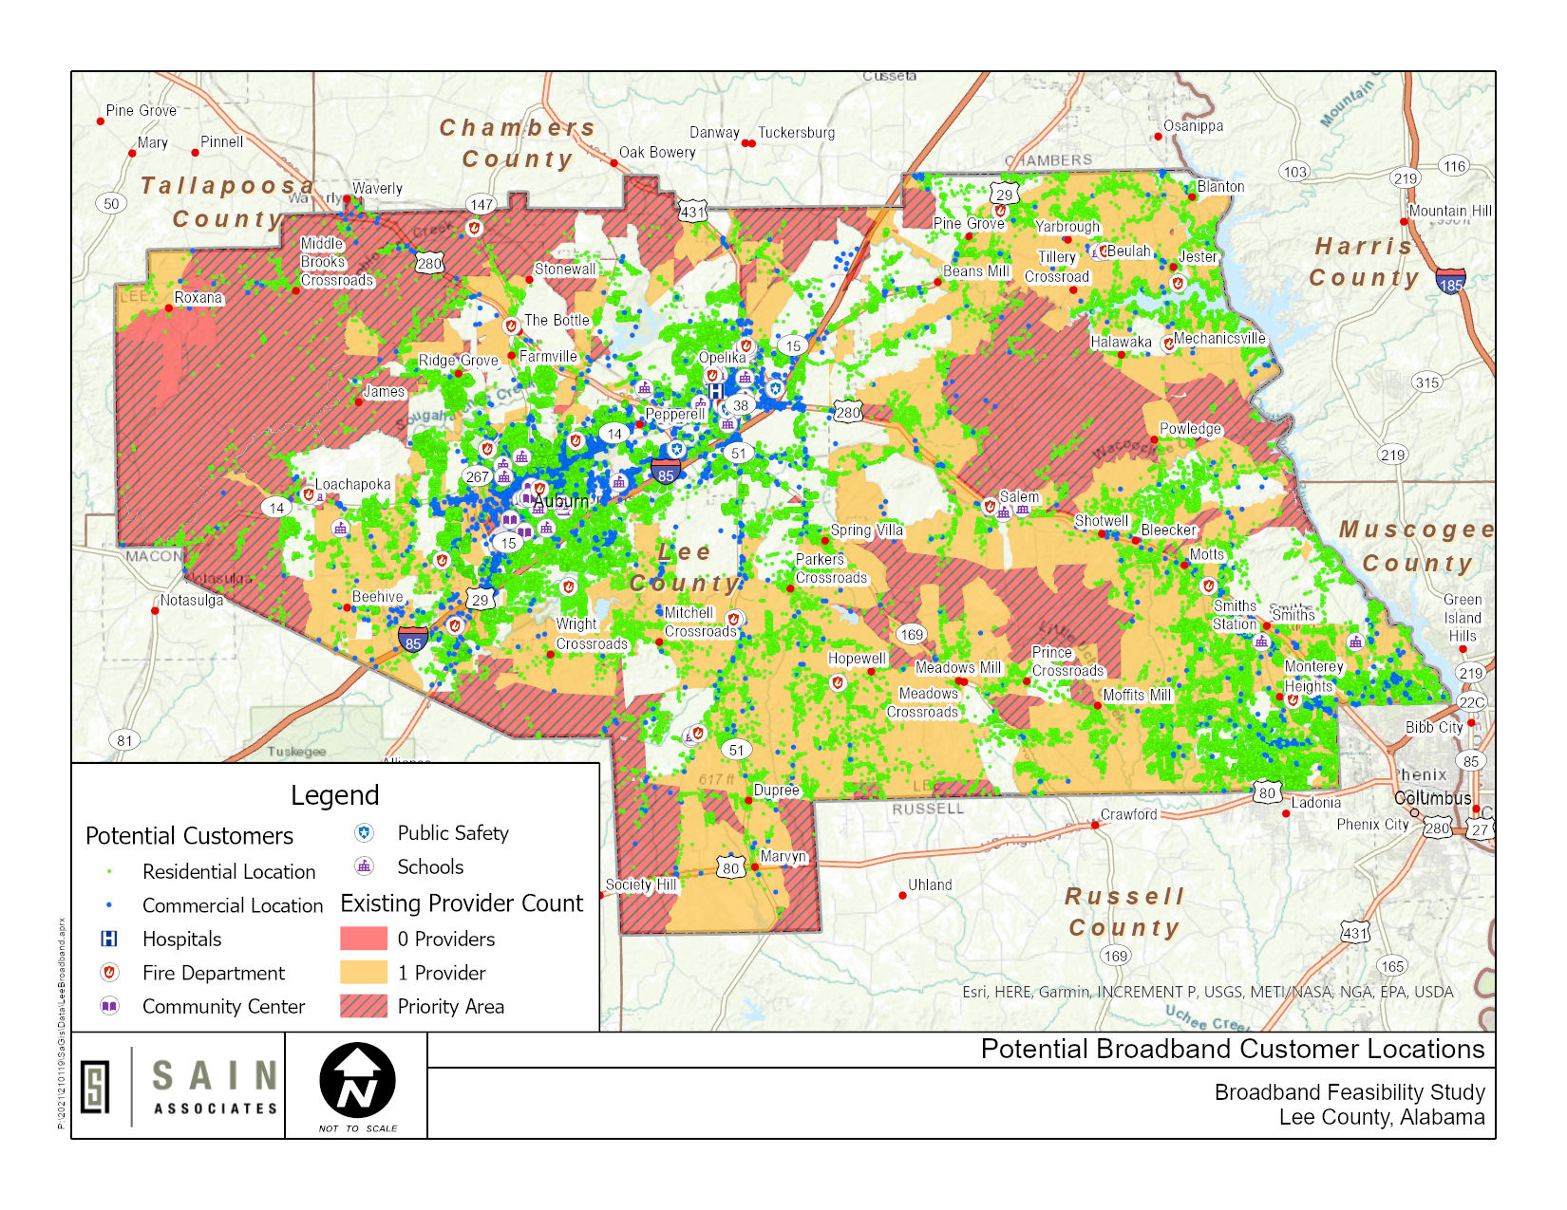
Existing Conditions
Condition based on 68,412 Potential Customers
Unserved area of the County (0 Broadband Providers) = 2.9%
Underserved area of the County (1 Broadband Provider) = 34.5%
Served by 2 or more Providers = 62.6%
Notes:
This ELCO specific study tells us many things such as the unserved and underserved areas of the county.
And we now know what percentage of our overall population have no access to a Broadband signal at their home of business.
And have a better understanding of what it would cost to expand infrastructure in ELCO
We know expanding Bb infrastructure would include hanging or burring physical fiber in the most densely populated underserved or unserved areas or it could mean installing towers to deliver a wireless Bb signal and our original plans included installing Hotspots in the least populated areas of the county where there would be very little Bb infrastructure installed so at minimum a citizen could drive to a nearby location and gain access to a signal.
And then just like all of us have experienced, along comes COVID-19 and all plans were changed.
ELCO BOE Superintendent Richard Dennis called in March saying he needed help in putting together a plan on how he could remotely deliver an education to his students if schools were closed and not reopened to finish the school year and he knew students having access to a broadband signal would be crucial to his plan
Well, we were ready to help.
Our original overall Bb infrastructure expansion plans included using hotspots last, but hotspots would now be installed first because they could be deployed quickly.
We just needed to determine where the hotpots should be installed that would service the greatest number of students and citizens, now and in the future and that data was available in our Broadband Feasibility Study.

Slide 7
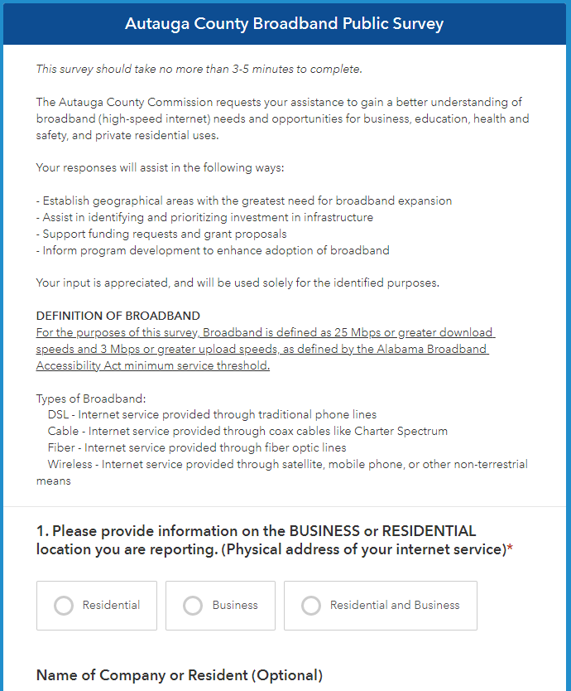
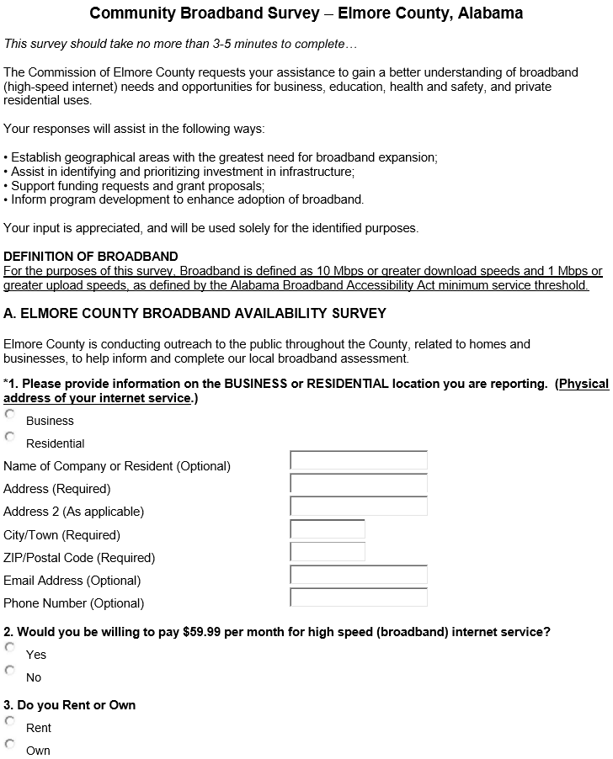
Community Broadband Survey
Survey asked about the following:
Address
Level of Service Feedback
Internet Speed Test for Each Location
Broadband Availability
In addition to the survey, we obtained GIS data from the revenue commissioner’s office and the Board of Education.
Notes:
Our county EDA took lead on this study and they initially engaged the services of a local IT company that help put together a broadband accessibility survey and an online form, that was also formatted to be viewed on a mobile device as well, that citizens could access and provide the needed information on their accessibility to broadband in the county.
This survey asked many questions such as your address, do you currently have broadband service and if you didn’t would you like to have broadband service, which providers were you aware of that served their address and then it asked them to conduct a broadband connection speed test that was embedded in the survey itself.
We then obtained GIS data from our revenue commissioner’s office showing the number of parcels and structures in the county so we could determine the population centers and business located near these population centers that had no access to broadband.
And also, we obtained data from the BOE showing historical and anticipated student population growth areas throughout the county where we could plan for an increase in demand over the coming years.
All of data was provided to Sain Associates where they were able to combine this data with maps showing the locations of fiber currently installed in the county and Said put off of this information into a useful format, that is now known as the ELCO Broadband Feasibility Study

Slide 8
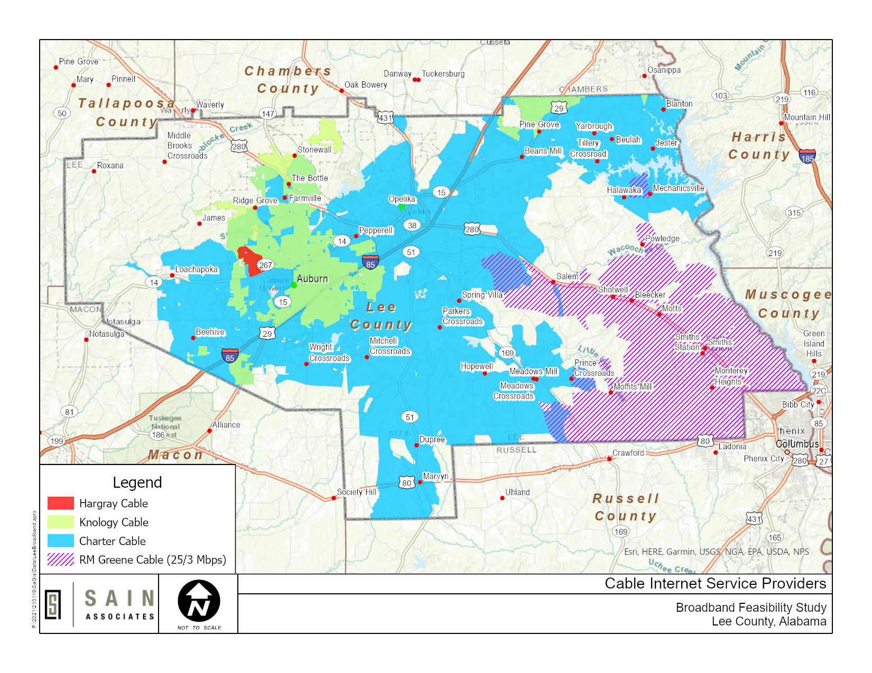
Major Interim Update
It was determined based on references from the ADECA broadband map and information collected from the public survey that the service area for RM Greene cable provider does meet the standard for broadband internet of 100/20 speeds
Numerous State grants were applied for from ADECA
Notes:
This ELCO specific study tells us many things such as the unserved and underserved areas of the county.
And we now know what percentage of our overall population have no access to a Broadband signal at their home of business.
And have a better understanding of what it would cost to expand infrastructure in ELCO
We know expanding Bb infrastructure would include hanging or burring physical fiber in the most densely populated underserved or unserved areas or it could mean installing towers to deliver a wireless Bb signal and our original plans included installing Hotspots in the least populated areas of the county where there would be very little Bb infrastructure installed so at minimum a citizen could drive to a nearby location and gain access to a signal.
And then just like all of us have experienced, along comes COVID-19 and all plans were changed.
ELCO BOE Superintendent Richard Dennis called in March saying he needed help in putting together a plan on how he could remotely deliver an education to his students if schools were closed and not reopened to finish the school year and he knew students having access to a broadband signal would be crucial to his plan
Well, we were ready to help.
Our original overall Bb infrastructure expansion plans included using hotspots last, but hotspots would now be installed first because they could be deployed quickly.
We just needed to determine where the hotpots should be installed that would service the greatest number of students and citizens, now and in the future and that data was available in our Broadband Feasibility Study.

Slide 9
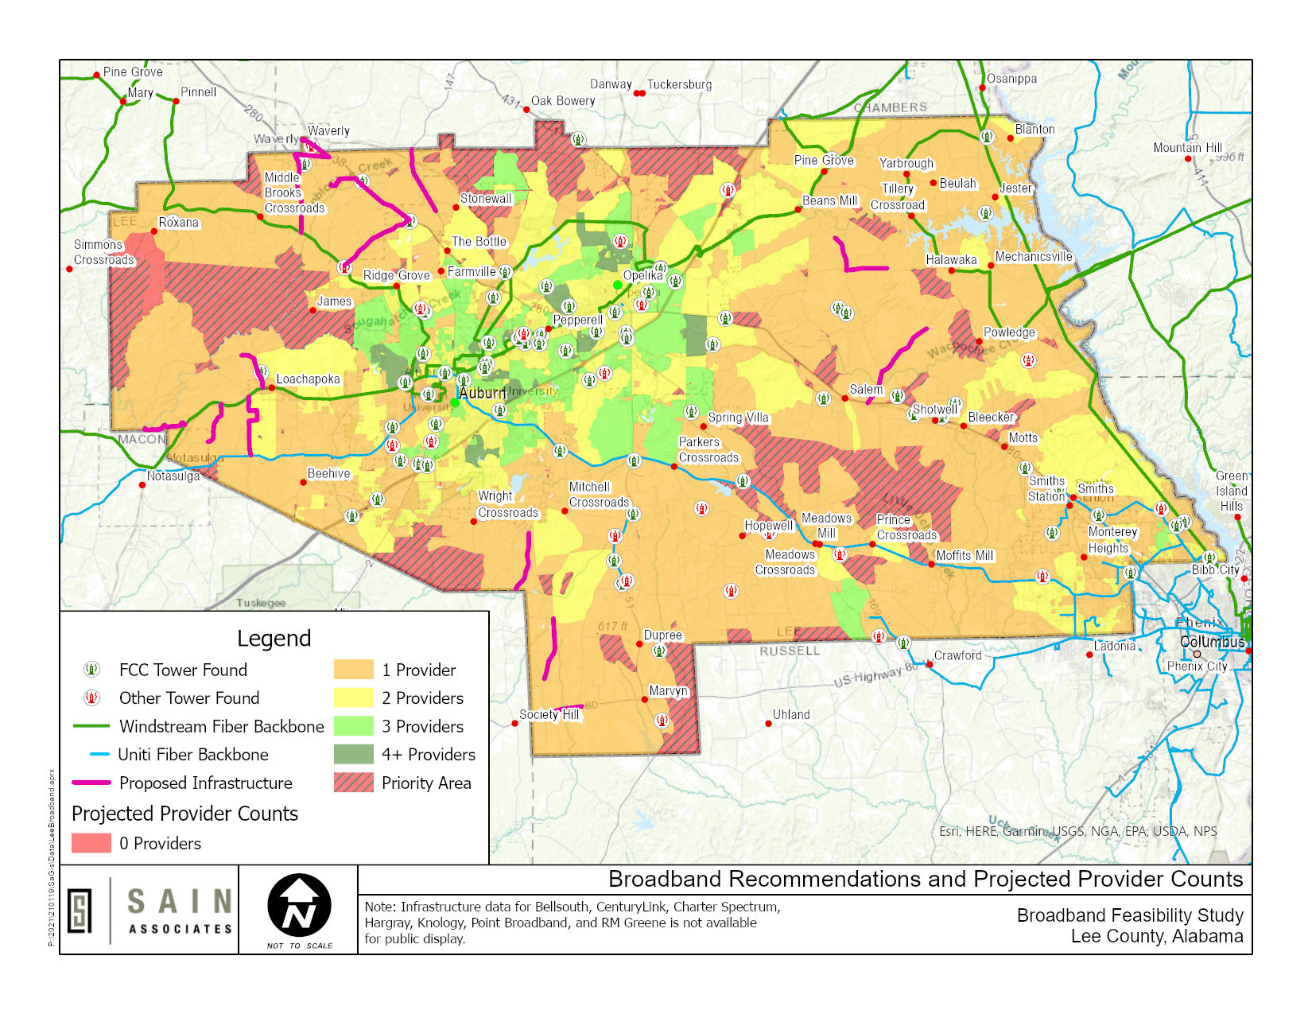
Initial Recommendations and Projections
Area Projections
0 Providers = 12.3%
1 Provider = 59.4%
2+ Providers = 27.3%
Potential Customer Projections
0 Providers = 1.4%
1 Provider = 36.0%
2+ Providers = 62.6%
Notes:
This ELCO specific study tells us many things such as the unserved and underserved areas of the county.
And we now know what percentage of our overall population have no access to a Broadband signal at their home of business.
And have a better understanding of what it would cost to expand infrastructure in ELCO
We know expanding Bb infrastructure would include hanging or burring physical fiber in the most densely populated underserved or unserved areas or it could mean installing towers to deliver a wireless Bb signal and our original plans included installing Hotspots in the least populated areas of the county where there would be very little Bb infrastructure installed so at minimum a citizen could drive to a nearby location and gain access to a signal.
And then just like all of us have experienced, along comes COVID-19 and all plans were changed.
ELCO BOE Superintendent Richard Dennis called in March saying he needed help in putting together a plan on how he could remotely deliver an education to his students if schools were closed and not reopened to finish the school year and he knew students having access to a broadband signal would be crucial to his plan
Well, we were ready to help.
Our original overall Bb infrastructure expansion plans included using hotspots last, but hotspots would now be installed first because they could be deployed quickly.
We just needed to determine where the hotpots should be installed that would service the greatest number of students and citizens, now and in the future and that data was available in our Broadband Feasibility Study.

Slide 10
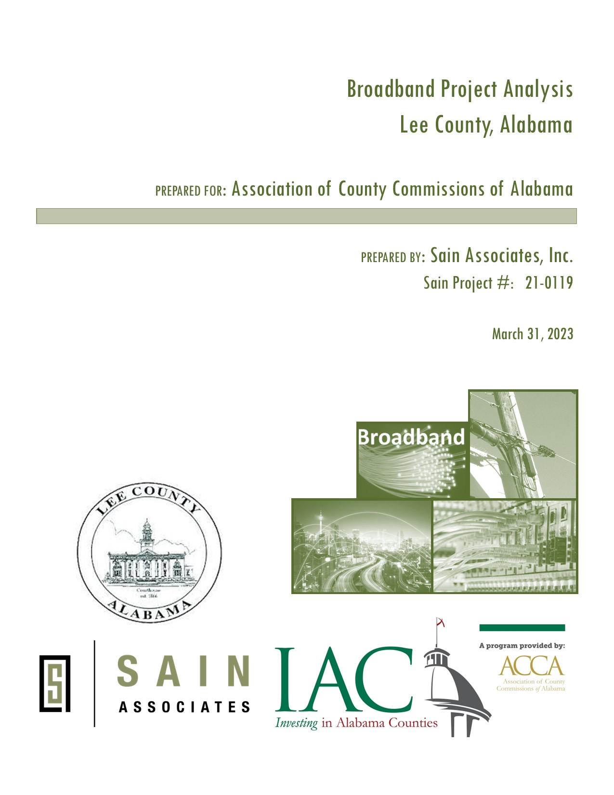
Project Analysis – Phase 2
Objectives of the Analysis:
Identify areas to be evaluated and potential customers
Develop parameters for evaluating projects
Define initial list of projects for preliminary study
Use scoring method to narrow list of projects to 10 projects
Develop budgetary cost estimates
Develop proposed implementation plan
Notes:
This ELCO specific study tells us many things such as the unserved and underserved areas of the county.
And we now know what percentage of our overall population have no access to a Broadband signal at their home of business.
And have a better understanding of what it would cost to expand infrastructure in ELCO
We know expanding Bb infrastructure would include hanging or burring physical fiber in the most densely populated underserved or unserved areas or it could mean installing towers to deliver a wireless Bb signal and our original plans included installing Hotspots in the least populated areas of the county where there would be very little Bb infrastructure installed so at minimum a citizen could drive to a nearby location and gain access to a signal.
And then just like all of us have experienced, along comes COVID-19 and all plans were changed.
ELCO BOE Superintendent Richard Dennis called in March saying he needed help in putting together a plan on how he could remotely deliver an education to his students if schools were closed and not reopened to finish the school year and he knew students having access to a broadband signal would be crucial to his plan
Well, we were ready to help.
Our original overall Bb infrastructure expansion plans included using hotspots last, but hotspots would now be installed first because they could be deployed quickly.
We just needed to determine where the hotpots should be installed that would service the greatest number of students and citizens, now and in the future and that data was available in our Broadband Feasibility Study.

Slide 11
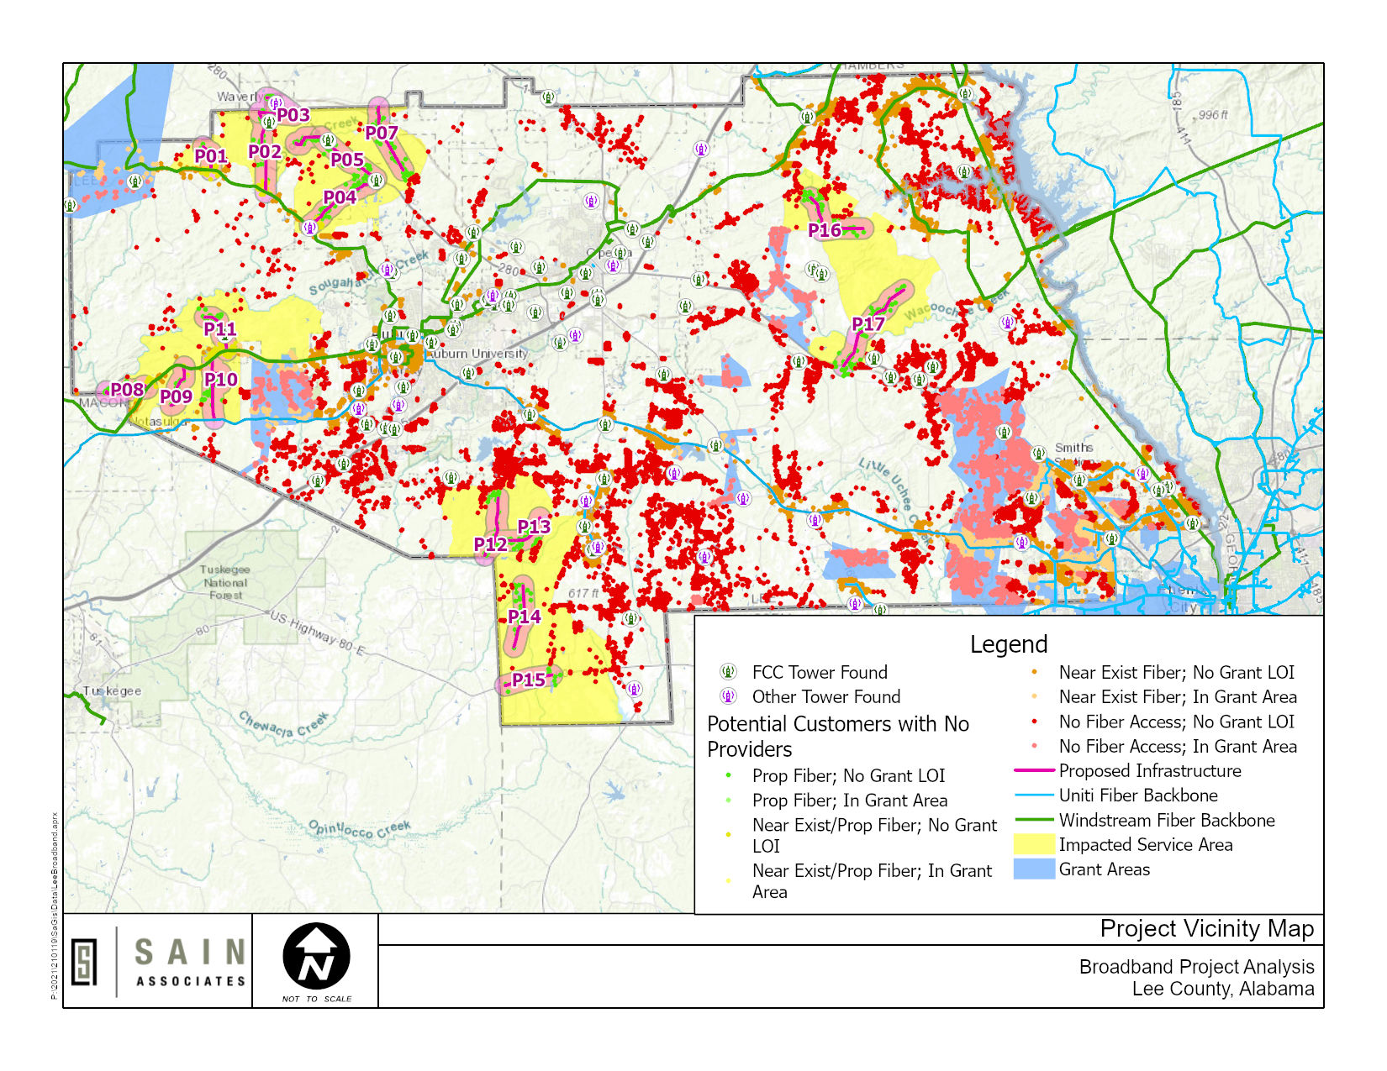
Evaluation of Potential
Customers
Potential customers in unserved and underserved areas
Excluded potential customers within 2,000’ of existing Fiber backbone
Excluded potential customers in areas covered by applied broadband grants
Notes:
This ELCO specific study tells us many things such as the unserved and underserved areas of the county.
And we now know what percentage of our overall population have no access to a Broadband signal at their home of business.
And have a better understanding of what it would cost to expand infrastructure in ELCO
We know expanding Bb infrastructure would include hanging or burring physical fiber in the most densely populated underserved or unserved areas or it could mean installing towers to deliver a wireless Bb signal and our original plans included installing Hotspots in the least populated areas of the county where there would be very little Bb infrastructure installed so at minimum a citizen could drive to a nearby location and gain access to a signal.
And then just like all of us have experienced, along comes COVID-19 and all plans were changed.
ELCO BOE Superintendent Richard Dennis called in March saying he needed help in putting together a plan on how he could remotely deliver an education to his students if schools were closed and not reopened to finish the school year and he knew students having access to a broadband signal would be crucial to his plan
Well, we were ready to help.
Our original overall Bb infrastructure expansion plans included using hotspots last, but hotspots would now be installed first because they could be deployed quickly.
We just needed to determine where the hotpots should be installed that would service the greatest number of students and citizens, now and in the future and that data was available in our Broadband Feasibility Study.

Slide 12
Evaluation Parameters
Notes:
This ELCO specific study tells us many things such as the unserved and underserved areas of the county.
And we now know what percentage of our overall population have no access to a Broadband signal at their home of business.
And have a better understanding of what it would cost to expand infrastructure in ELCO
We know expanding Bb infrastructure would include hanging or burring physical fiber in the most densely populated underserved or unserved areas or it could mean installing towers to deliver a wireless Bb signal and our original plans included installing Hotspots in the least populated areas of the county where there would be very little Bb infrastructure installed so at minimum a citizen could drive to a nearby location and gain access to a signal.
And then just like all of us have experienced, along comes COVID-19 and all plans were changed.
ELCO BOE Superintendent Richard Dennis called in March saying he needed help in putting together a plan on how he could remotely deliver an education to his students if schools were closed and not reopened to finish the school year and he knew students having access to a broadband signal would be crucial to his plan
Well, we were ready to help.
Our original overall Bb infrastructure expansion plans included using hotspots last, but hotspots would now be installed first because they could be deployed quickly.
We just needed to determine where the hotpots should be installed that would service the greatest number of students and citizens, now and in the future and that data was available in our Broadband Feasibility Study.

Slide 13
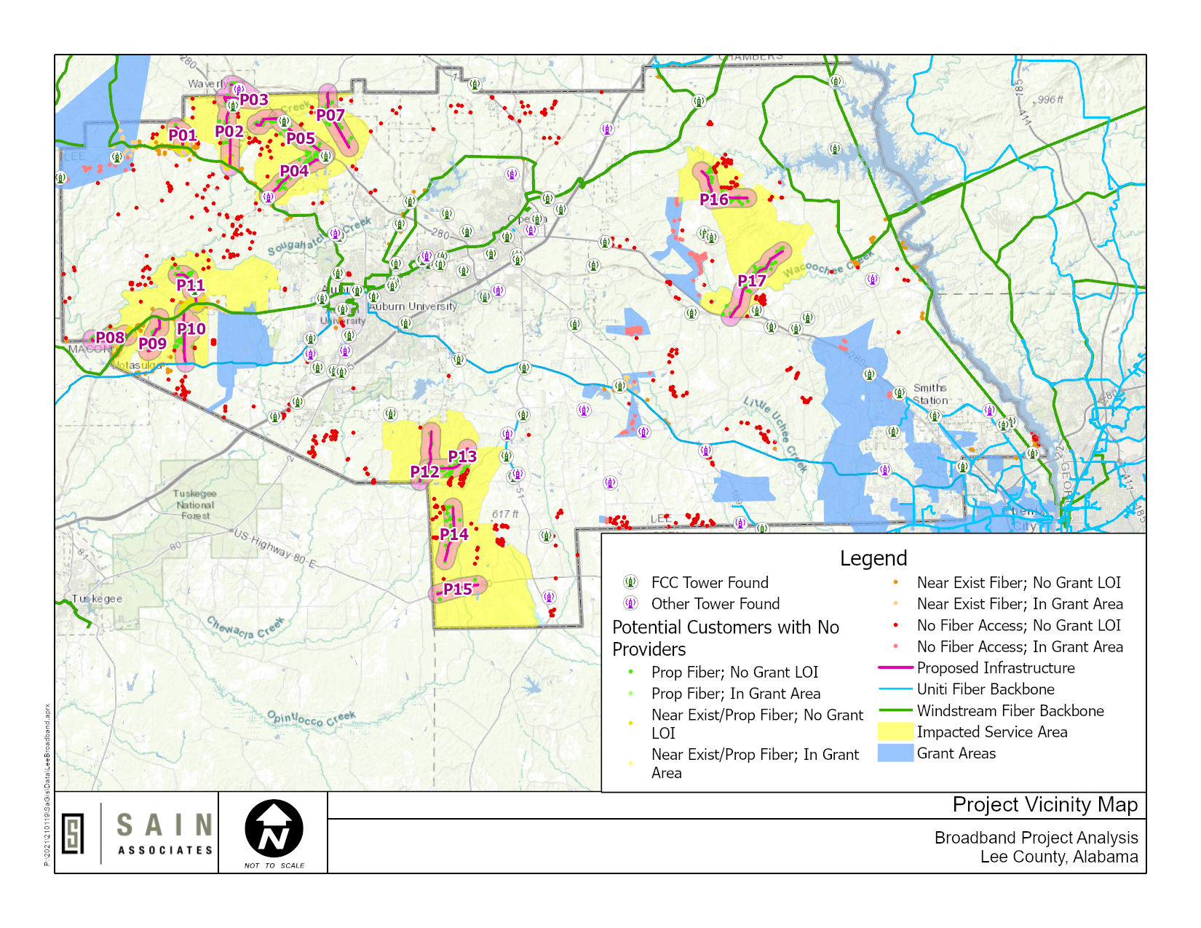
Preliminary Project Map
Lee Rd 75 Fiber
Lee Rd 188 N Fiber
Waverly Fiber
Lee Rd 84 Fiber
US-280 W Fiber
Lee Rd 453 Fiber
AL-147 N Fiber
Lee Rd 2038 Fiber
Lee Rd 1 Fiber
Lee Rd 188 S Fiber
Waverly Rd Fiber
Lee Rd 54 Fiber
Lee Rd 27 Fiber
Lee Rd 29 Fiber
US-80 Fiber
Lee Rd 252 Fiber
Lee Rd 254 Fiber
Notes:
This ELCO specific study tells us many things such as the unserved and underserved areas of the county.
And we now know what percentage of our overall population have no access to a Broadband signal at their home of business.
And have a better understanding of what it would cost to expand infrastructure in ELCO
We know expanding Bb infrastructure would include hanging or burring physical fiber in the most densely populated underserved or unserved areas or it could mean installing towers to deliver a wireless Bb signal and our original plans included installing Hotspots in the least populated areas of the county where there would be very little Bb infrastructure installed so at minimum a citizen could drive to a nearby location and gain access to a signal.
And then just like all of us have experienced, along comes COVID-19 and all plans were changed.
ELCO BOE Superintendent Richard Dennis called in March saying he needed help in putting together a plan on how he could remotely deliver an education to his students if schools were closed and not reopened to finish the school year and he knew students having access to a broadband signal would be crucial to his plan
Well, we were ready to help.
Our original overall Bb infrastructure expansion plans included using hotspots last, but hotspots would now be installed first because they could be deployed quickly.
We just needed to determine where the hotpots should be installed that would service the greatest number of students and citizens, now and in the future and that data was available in our Broadband Feasibility Study.

Slide 14
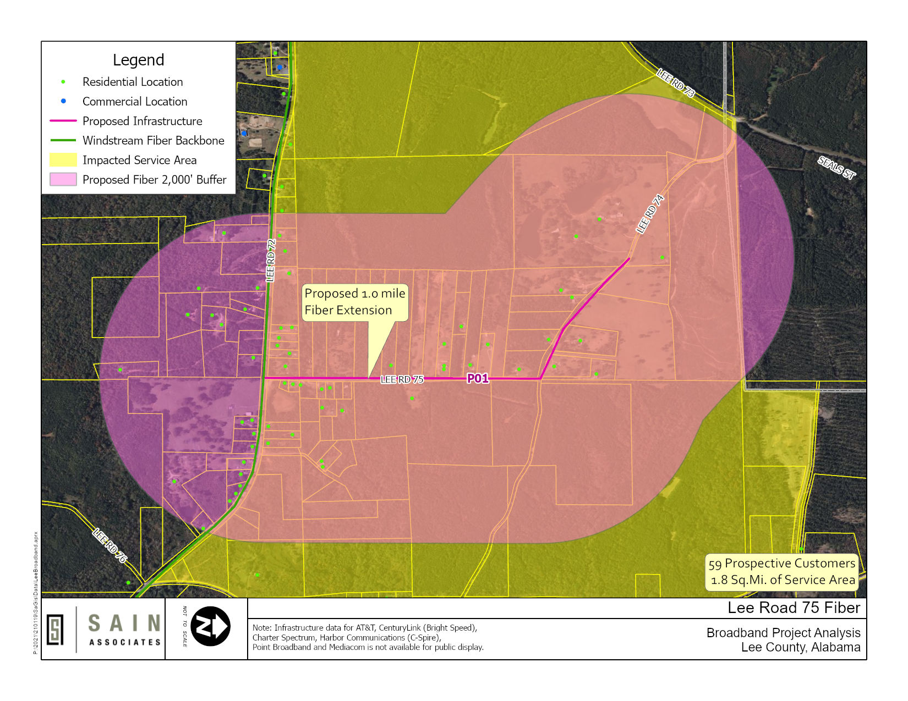
Detailed Project Maps
Shows:
Proposed infrastructure improvement
Potential customers
Service areas impacted
Notes:
This ELCO specific study tells us many things such as the unserved and underserved areas of the county.
And we now know what percentage of our overall population have no access to a Broadband signal at their home of business.
And have a better understanding of what it would cost to expand infrastructure in ELCO
We know expanding Bb infrastructure would include hanging or burring physical fiber in the most densely populated underserved or unserved areas or it could mean installing towers to deliver a wireless Bb signal and our original plans included installing Hotspots in the least populated areas of the county where there would be very little Bb infrastructure installed so at minimum a citizen could drive to a nearby location and gain access to a signal.
And then just like all of us have experienced, along comes COVID-19 and all plans were changed.
ELCO BOE Superintendent Richard Dennis called in March saying he needed help in putting together a plan on how he could remotely deliver an education to his students if schools were closed and not reopened to finish the school year and he knew students having access to a broadband signal would be crucial to his plan
Well, we were ready to help.
Our original overall Bb infrastructure expansion plans included using hotspots last, but hotspots would now be installed first because they could be deployed quickly.
We just needed to determine where the hotpots should be installed that would service the greatest number of students and citizens, now and in the future and that data was available in our Broadband Feasibility Study.

Slide 15
Thank You
Daniel R. Mellott, GISP
Sain Associates
205-790-5752
dmellott@sain.com
In cooperation with:
Notes:
This ELCO specific study tells us many things such as the unserved and underserved areas of the county.
And we now know what percentage of our overall population have no access to a Broadband signal at their home of business.
And have a better understanding of what it would cost to expand infrastructure in ELCO
We know expanding Bb infrastructure would include hanging or burring physical fiber in the most densely populated underserved or unserved areas or it could mean installing towers to deliver a wireless Bb signal and our original plans included installing Hotspots in the least populated areas of the county where there would be very little Bb infrastructure installed so at minimum a citizen could drive to a nearby location and gain access to a signal.
And then just like all of us have experienced, along comes COVID-19 and all plans were changed.
ELCO BOE Superintendent Richard Dennis called in March saying he needed help in putting together a plan on how he could remotely deliver an education to his students if schools were closed and not reopened to finish the school year and he knew students having access to a broadband signal would be crucial to his plan
Well, we were ready to help.
Our original overall Bb infrastructure expansion plans included using hotspots last, but hotspots would now be installed first because they could be deployed quickly.
We just needed to determine where the hotpots should be installed that would service the greatest number of students and citizens, now and in the future and that data was available in our Broadband Feasibility Study.

